Slide 1


Theory of Computation: A Problem-Solving Approach
Chapter – 3: Non-Deterministic Finite Automata

Slide 2
Learning Objectives
Learn to use non-determinism as a tool in designing automata.
Learn how to design non-deterministic automata for a given problem.
Learn to convert a non-deterministic automaton to a deterministic one through subset construction.
Learn the use of λ-transitions in designing non-deterministic automata.
Learn to minimize the states in an automaton.
Learn to compare two automata to determine their equivalence.
Understand how finite state transducers work.

Slide 3
The Idea of Non-Determinism
More than one choice for the computing machine
More than transition for the same current state and the same input symbol
More than one resulting state
Machine stays simultaneously in multiple states
Any one path leads to a final state: machine accepts input
Two ways to understand non-deterministic behavior:
Multiple parallel threads of execution
Machine guessing the right choice each time!

Slide 4
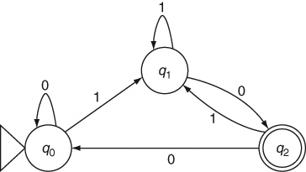
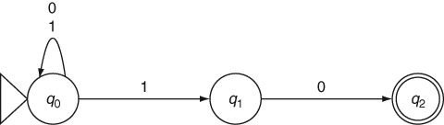
Example 3.1: DFA and NFA
Strings ending with 10

Slide 5
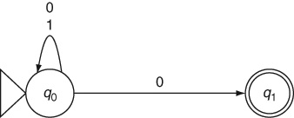
NFA: Example 3.2
Even numbers

Slide 6
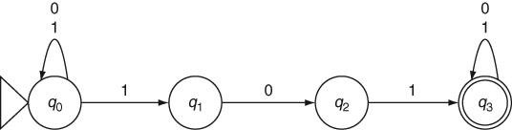
NFA: Example 3.3
Searching for the keyword 101

Slide 7
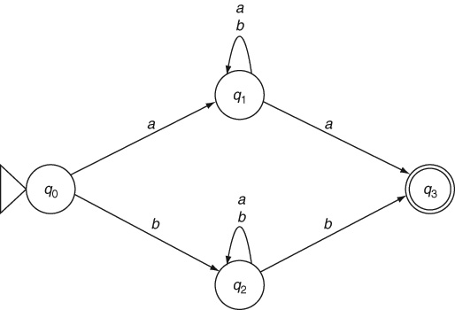
NFA: Example 3.4
Same first and last symbols

Slide 8
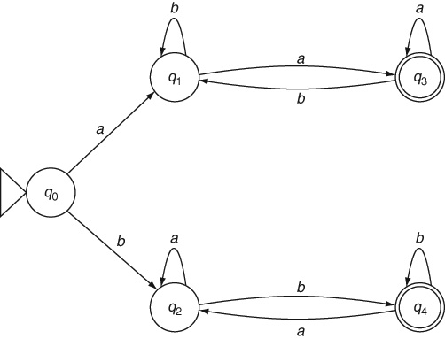
DFA: Example 3.4
Same first and last symbols

Slide 9
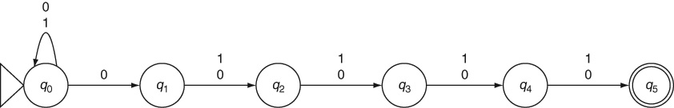
NFA: Example 3.5
Fifth symbol from the end is a 0

Slide 10
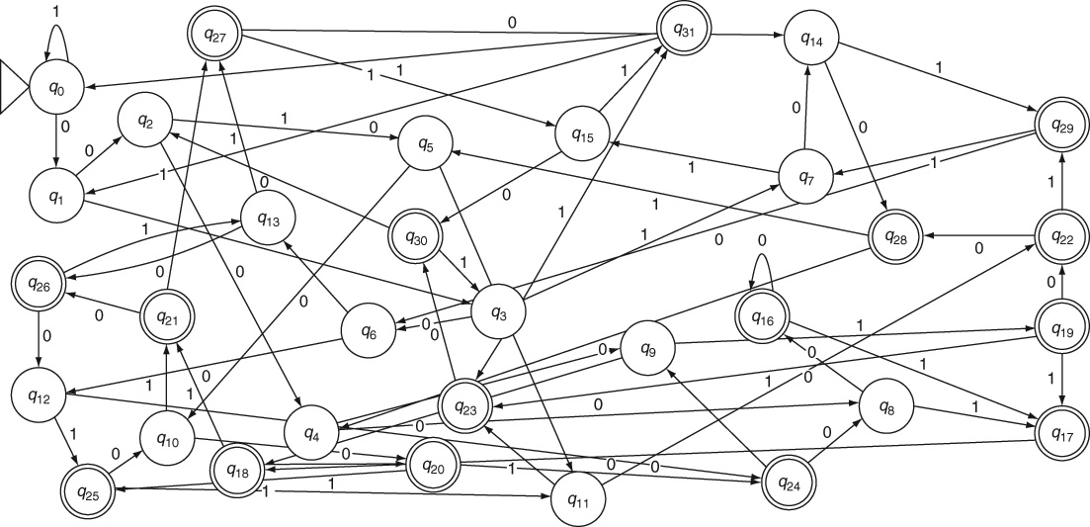
DFA: Example 3.5 (also Example 2.14)
Fifth symbol from the end is a 0

Slide 11
Advantages of NFA over DFA
Non-determinism makes it easier to design and construct an automaton by ensuring that it is equally easy to handle constraints in any part of the input string without a need for backtracking in the case of incorrect decisions made by the automaton; and
Non-determinism reduces the number of states (and transitions) in the automaton.

Slide 12
Eliminating Non-Determinism: NFA to DFA
Algorithm
Starting from the initial state q₀ of the NFA,
For each symbol in the alphabet, repeat
Determine the set of states that the NFA can reach from the current state (s) for the input symbol;
If this is different from all the sets already enumerated,
Create a new state Q_{i} in the DFA for this set.
Add the new state to the set of states in the enumeration until no new set can e added.
For each state Q in the DFA and for each symbol in the alphabet,
Add a transition to a DFA state that corresponds to any of the transitions in the NFA.

Slide 13
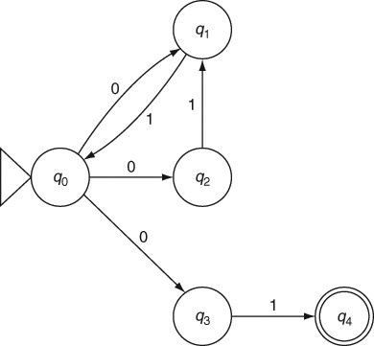
NFA to DFA: Example 3.6

Slide 14
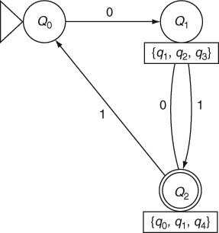
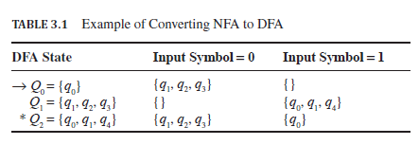
NFA to DFA: Example 3.6

Slide 15
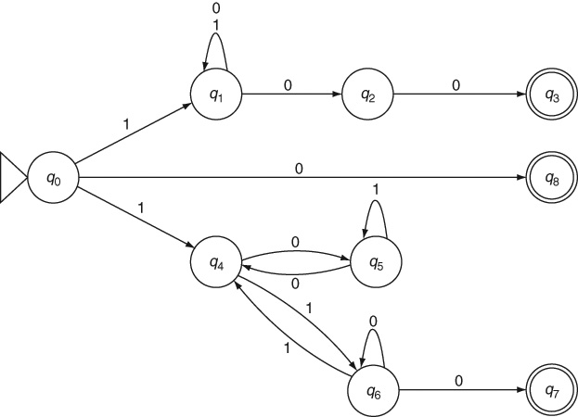
NFA to DFA: Example 3.7
Binary numbers divisible by either 4 or 6

Slide 16
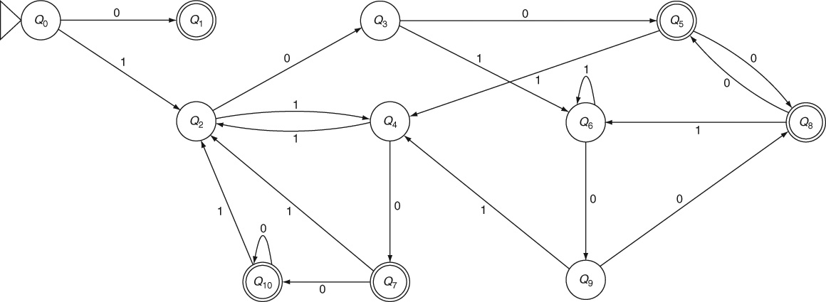
Resulting DFA: Example 3.7

Slide 17
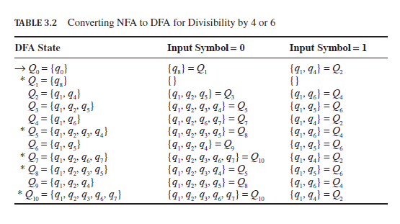
Subset Construction: Example 3.7

Slide 18
Meanings of NFA States: Example 3.7
q₀ is the start state.
q₁ is the state where all symbols are consumed before looking for an ending with 00.
q₂ is where one 0 has been seen, that is, the number so far is an even number.
q₃ is the final state where the input is divisible by 4.
q₄ is the state where mod 3 of the number so far is 1.
q₅ is the state where mod 3 of the number so far is 2.
q₆ is the state where the number so far is divisible by 3.
q₇ is the final state where the number is divisible by 6.
q₈ is the special final state for accepting the number 0.

Slide 19
Meanings of DFA States: Example 3.7
Q₁ is the special final state for accepting the number 0.
Q₅ is the state where the number is divisible by 4 but not by 6 (mod 6 is 4).
Q₇ is the state where the number is not divisible by 4 but is divisible by 6.
Q₈ is the state where the number is divisible by 4 but not by 6 (mod 6 is 2).
Q₁₀ is the state where the number is divisible by both 4 and 6.
The number so far is odd in states Q₂, Q₄ and Q₆
The number so far is even but not divisible by either 4 or 6 in Q₃ and Q₉

Slide 20
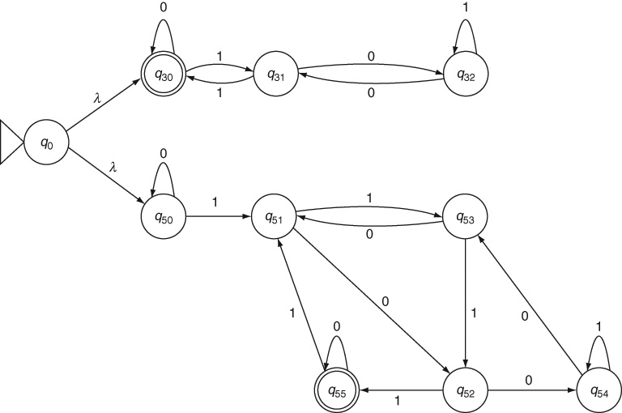

Jumping States without Input: λ-Transitions
Example 3.8: Numbers divisible by either 3 or 5
NFA:

Slide 21
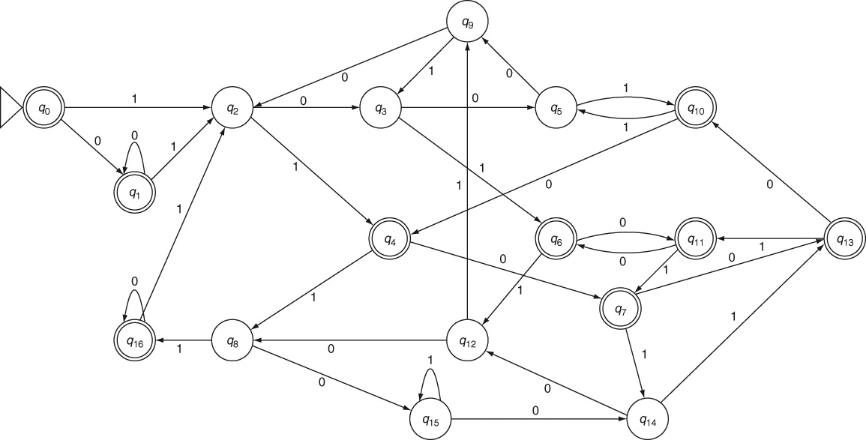
Resulting DFA: Example 3.8

Slide 22
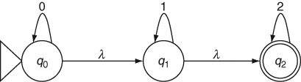
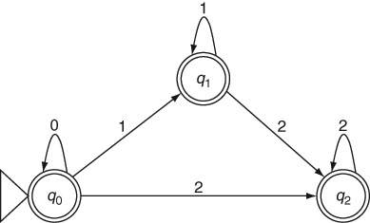
NFA to DFA: Example 3.9
0 s, 1 s and 2 s in that order

Slide 23
Mark & Reduce: Method for Minimizing DFA
Algorithm
First deleted any state that is unreachable from the start state;
For each pair of states where one is a final state and the other is non-final,
mark them as distinguishable;
For each pair of states q_{i} and q_{j,}
For each symbol in the alphabet,
If qi takes the automaton to q_{m} and q_{j} to q_{n} and
If q_{m} and q_{n} are already marked as distinguishable,
Then mark q_{i} and q_{j} as distinguishable;
Repeat the above until no more pairs can be marked;
All the pairs of states that are not marked are indistinguishable;
Collapse indistinguishable pairs to single states and merge their transitions.

Slide 24
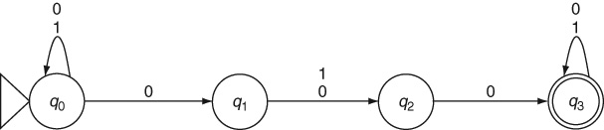
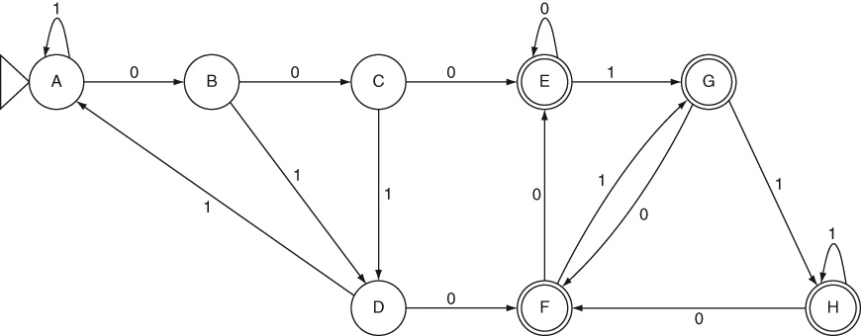
Minimizing DFA: Example 3.10
NFA and DFA for multiple keyword search: 010 or 000

Slide 25
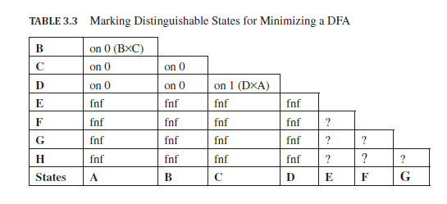
Table Filling: Example 3.10

Slide 26
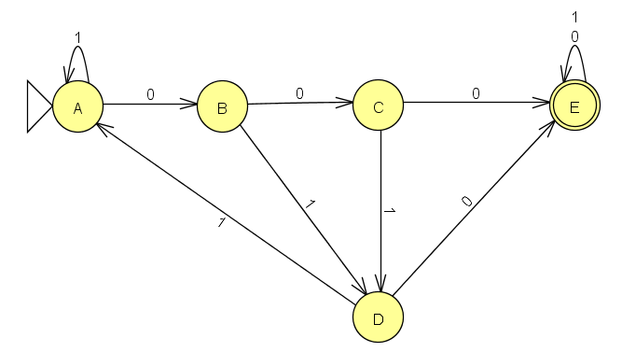
Minimized DFA: Example 3.10

Slide 27
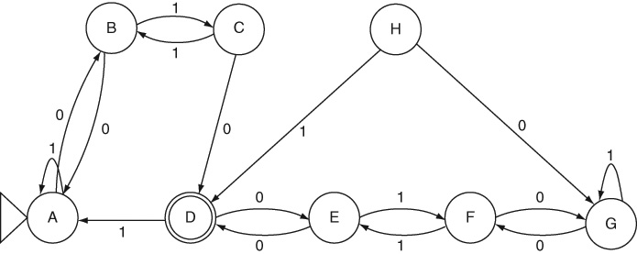
Example 3.11
DFA for minimization

Slide 28
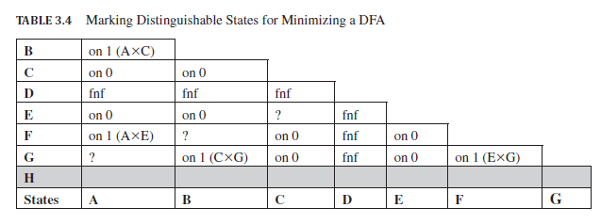
Table Filling: Example 3.11

Slide 29
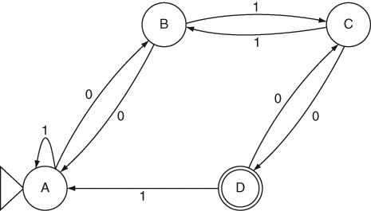
Minimized DFA: Example 3.11

Slide 30
Finite State Transducers
Produce output strings
Output symbol defined per state: Moore machine
Output symbol defined per transition: Mealy machine

Slide 31
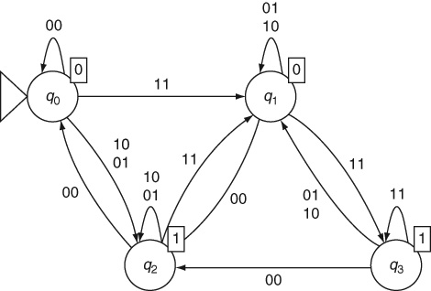
Moore Machine Binary Adder: Example 3.12

Slide 32
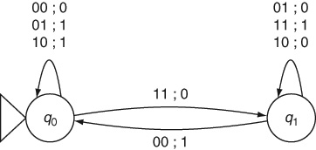
Mealy Machine Binary Adder: Example 3.13

Slide 33

Mealy Machine Translator: Example 3.14

Slide 34
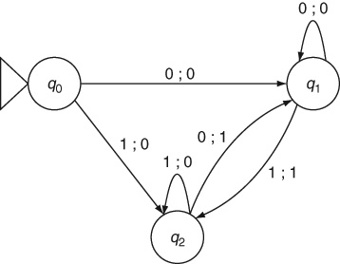
Mealy Machine Edge Detector: Example 3.15

Slide 35
Theorems
Theorem 1. Equivalence of NFA and DFA: For every nondeterministic finite automaton M_{n}, there is an equivalent deterministic finite automaton M_{d} whose language is the same as that of the nondeterministic automaton, that is, M_{n}.language = M_{d}.language.
Theorem 2: DFA minimization: The minimal DFA obtained by marking distinguishable states and collapsing indistinguishable states is equivalent to the original DFA (i.e., it accepts the same language).

Slide 36
Key Ideas
A non-deterministic finite automaton can have more than one transition from the same state for the same input symbol.
It can guess the right choice for accepting an input string. Equivalently, it can try out all the choices in parallel to see if any one leads to acceptance of the input string.
Non-deterministic automata are often easier for us to design.
Non-deterministic automata can also change states without consuming any input symbol. NFA with such λ-transitions make it further easy for us to design them for a given problem. They also help us combine two or more automata to solve a more complex problem.
Non-deterministic finite automata are strictly equivalent to deterministic ones. They have the same computing power as deterministic ones, in terms of the range of problems they can solve (or the range of input strings they can handle).

Slide 37
Key Ideas (contd..)
The method of subset construction is used to convert an NFA to an equivalent DFA.
A DFA obtained from an equivalent NFA usually has more states than the NFA. In the worst case, the number of states in the resulting DFA can be exponential in the number of NFA states.
A DFA can be minimized by identifying and merging indistinguishable states. Indistinguishable states denote the same equivalence class of (sub)strings and can be merged into a single state. The minimal number of states in an equivalent DFA is the total number of equivalence classes of strings. This number must be finite for a regular language according to the Myhill–Nerode theorem (Theorem 10 in Appendix B).
Book-keeping in minimizing a DFA is made easy by applying a table-filling technique to mark all distinguishable pairs of states.
Unlike finite automata which merely accept or reject an input string, finite-state transducers such as Moore and Mealy Machines produce an output while processing the input string.

Slide 38
End of Chapter 3

